Slide 1
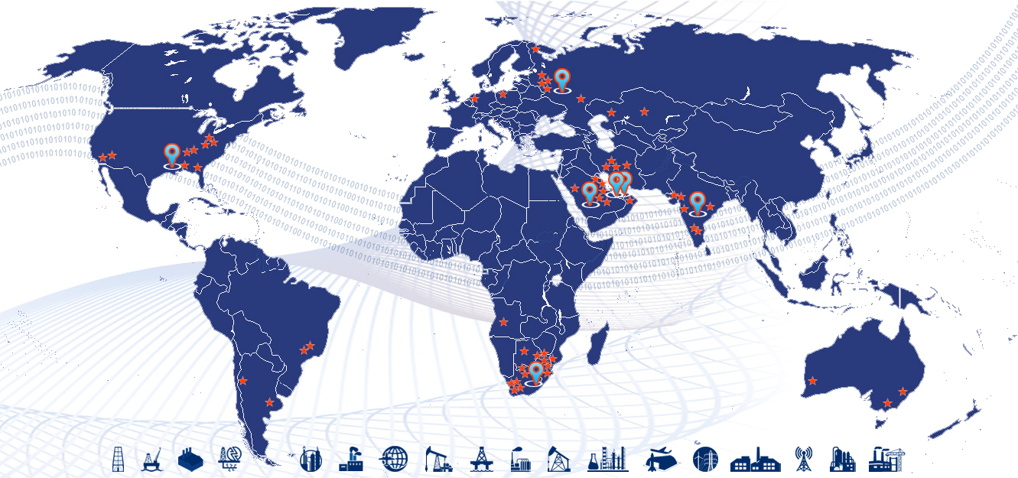
PiLog - Data Solution Architecture

Slide 2









PiLog - Data & Process Transformation Company
Established in 1996, PiLog Group is a global group of independent companies, specializing in Quality Data and Digital Governance & Analytical solutions supporting multiple data domains in a variety of industries all over the globe. The PiLog solutions are state of the art, focused on creating a common business language and managing the rules for the creation of high quality, multilingual terminology using Machine Learning, Artificial Intelligence technologies & human-augmented algorithms for our customers who are eager to transform their businesses digitally.
PiLog provides exclusive technical dictionaries, industrial libraries with content repositories that are the culmination of research, development, and execution over the past twenty years embedded into the platform of PiLog – Data Quality Hub. All our methodologies, processes, solutions are compliant with international standards for delivering seamless systematic integration of content into various platforms and ERPs such as SAP, S4 HANA, Oracle ERP Cloud, Maximo & MS Dynamics, etc.
PiLog India Private Limited, India
PiLog India Labs (R&D)
PiLog Technology Solutions, Abu Dhabi, UAE
PiLog Pty Ltd, Dubai, UAE
PiLog Saudi International, KSA
PiLog Innovative Solutions, Qatar
PiLog Inc, USA
PiLog Pty Ltd, RSA
PiLog Europe, NL
www.piloggroup.com

Slide 3

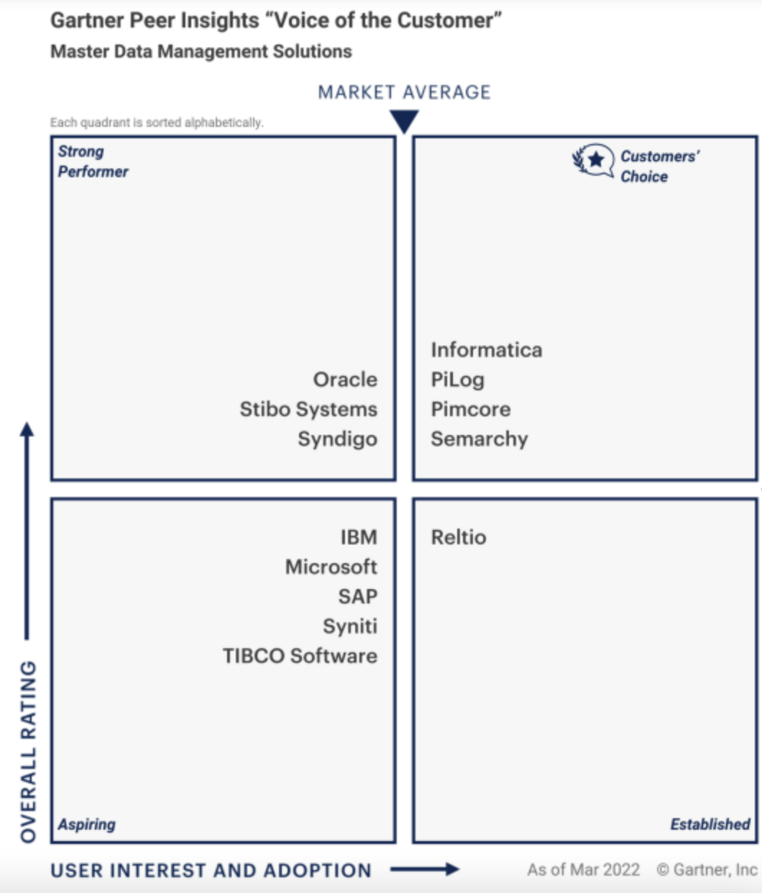
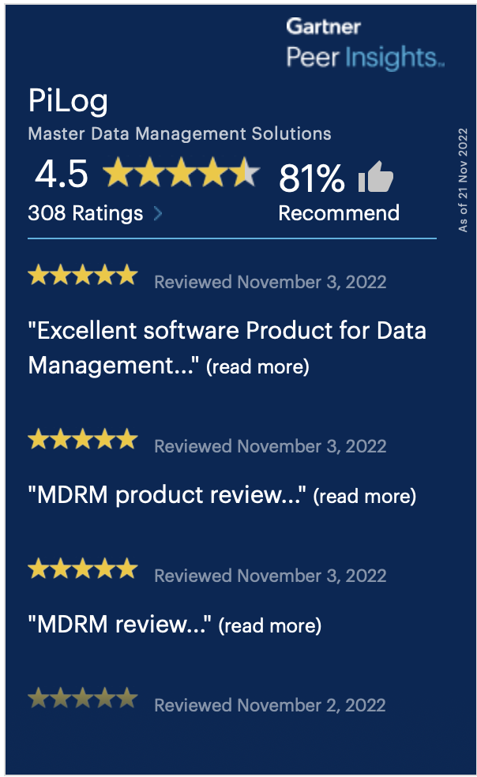
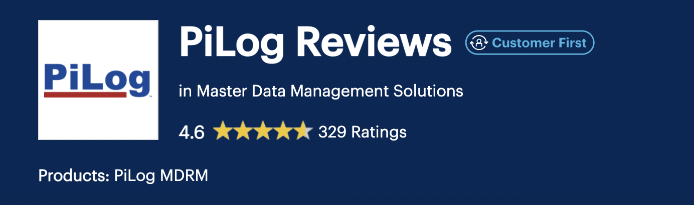
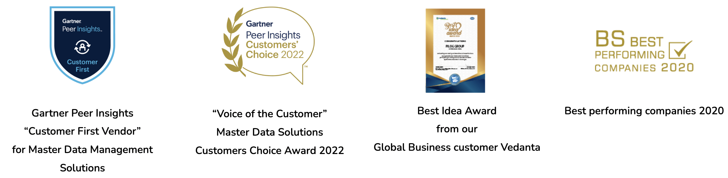
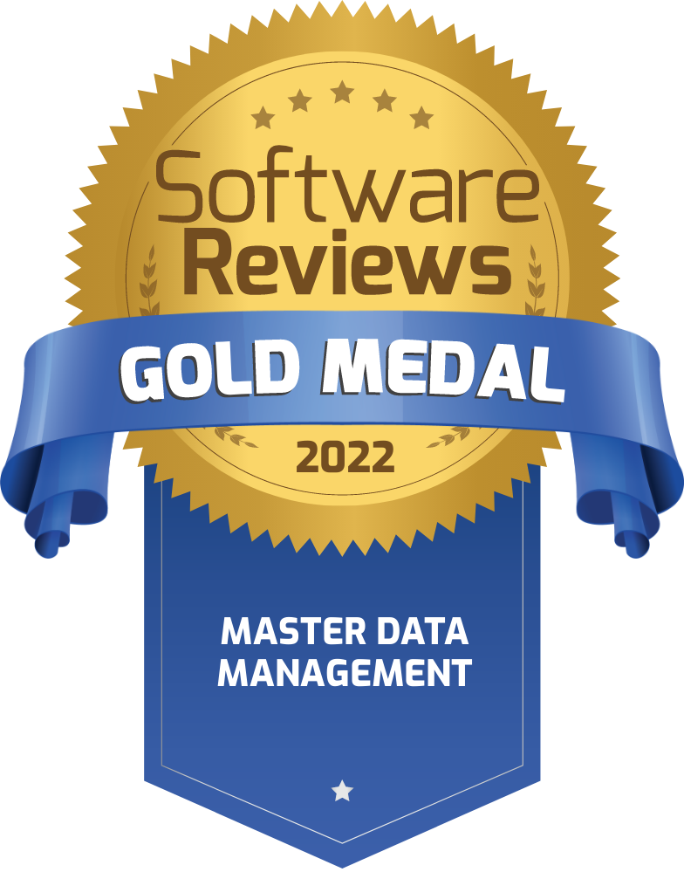
Gartner Recognitions
PiLog named as a “Niche Player” consecutively in
Gartner’s Magic Quadrant under
“Master Data Management Solutions”
Gartner Peer Insights “Voice of the Customer” Master Data Solutions Customers’ Choice Award 2022 positioned PiLog to be preferred partner of choice for our Customers
https://www.gartner.com/reviews/market/master-data-management-solutions/vendor/pilog
Source: Gartner
www.piloggroup.com

Slide 4



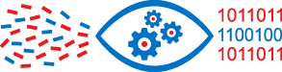

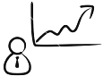
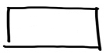



Solution Architecture Framework
Data Source
Data Staging for Bulk Upload
Data Governance (One by One Registration)
Repository Records (PPR)
Repository Records (PPR)
Master Data Dictionary (PPO)
Auto Structure Algorithms/AI API
Master Data Dictionary (PPO)
Auto Structure Algorithms/AI API
EMDAD
Master Data Governance Solution
ETL
EMDAD
(Bulk upload Staging Area)
Legacy
Extract
De-Duplication
De-Duplication
Industry Standards
Standard Descriptions
Transform
Classification
Output Parameters
Class
HS Code
New Record Creation
Description Change
Record Extension
Record Block/un block
Value Standardization
Description Generation
UNSPSC
NATO
Performance Analysis
Dashboards and Business Reporting

